Slide 1
CORE JAVA
NEEHARIKA

Slide 2
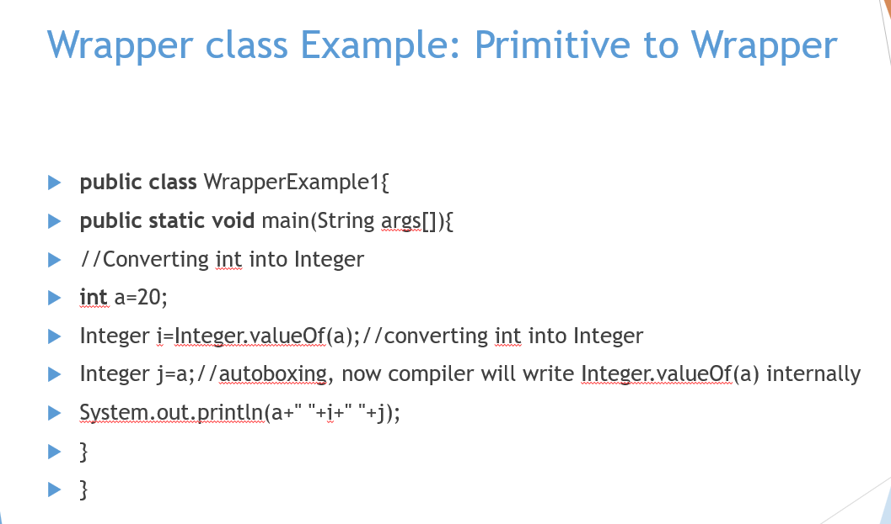

Slide 3
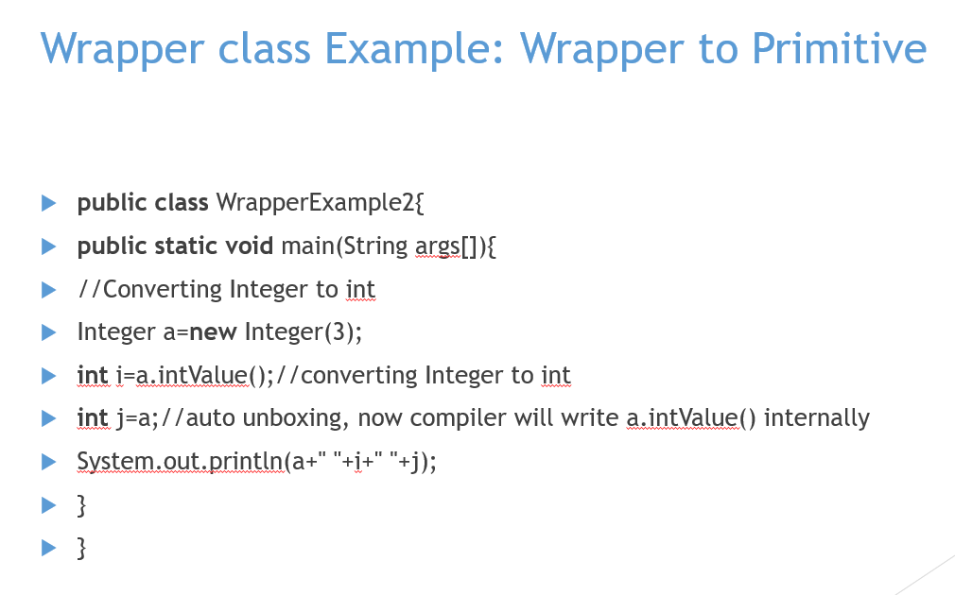

Slide 4
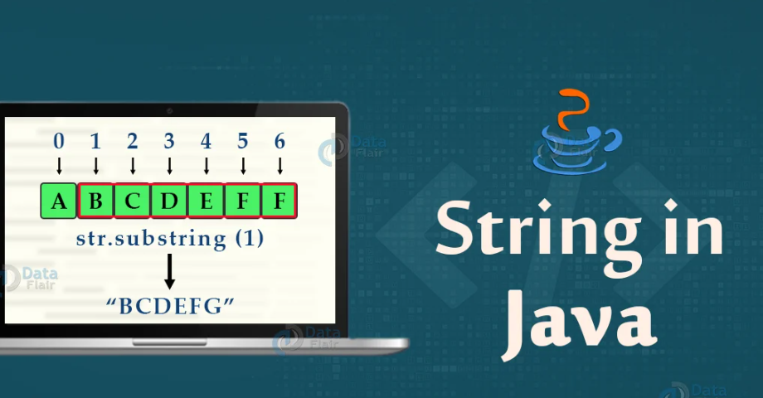

Slide 5
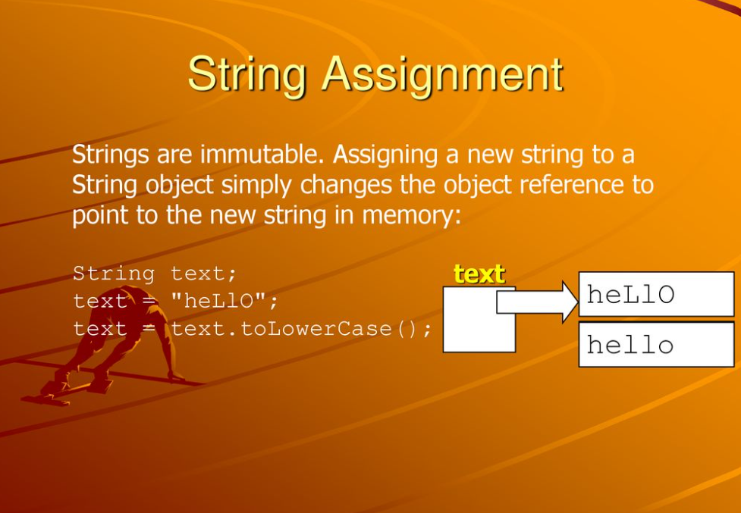

Slide 6
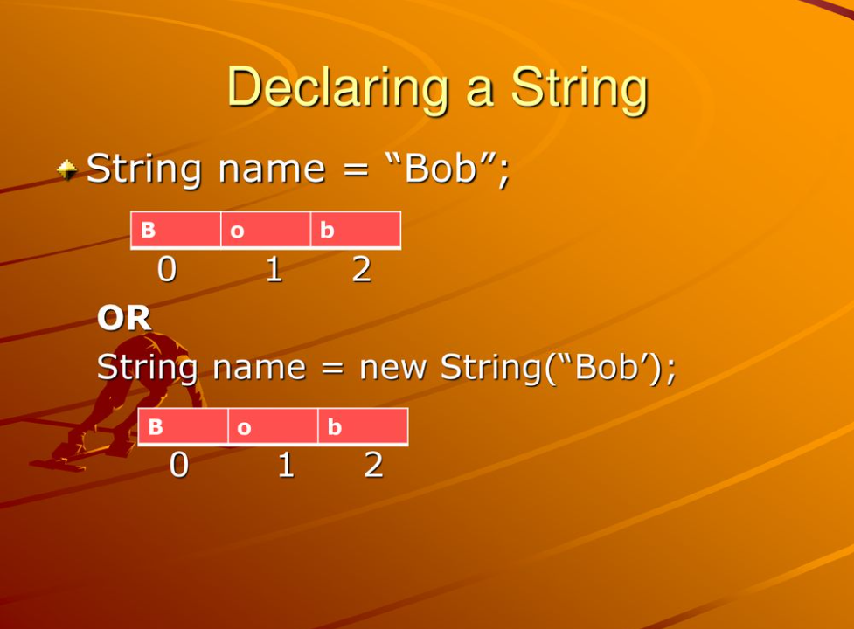

Slide 7
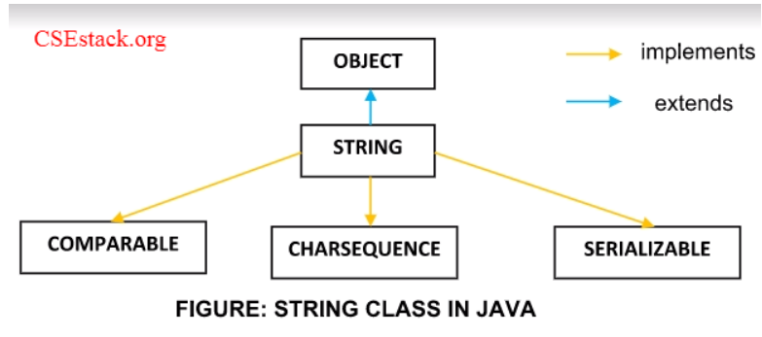


Slide 8
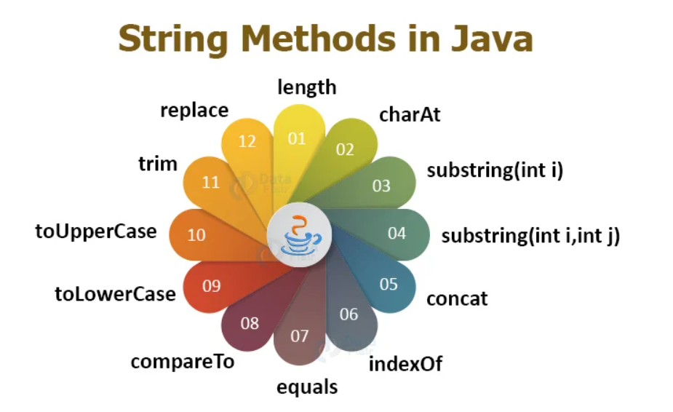

Slide 9
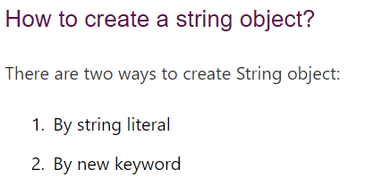

Slide 10
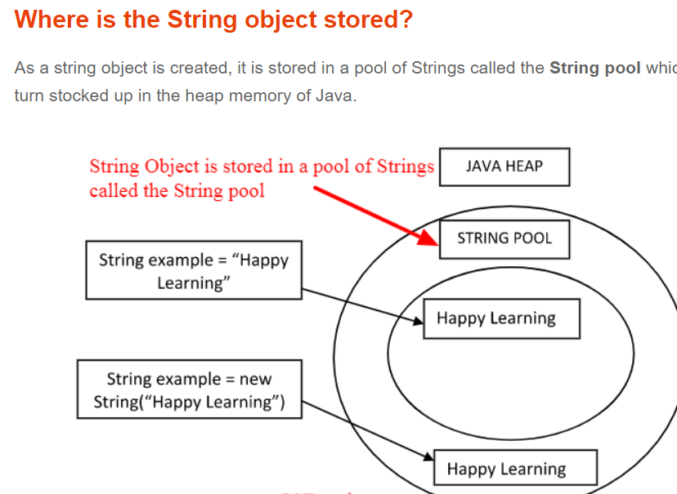

Slide 11
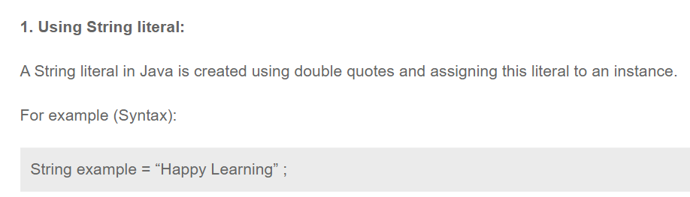

Slide 12
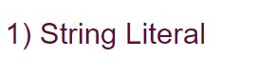
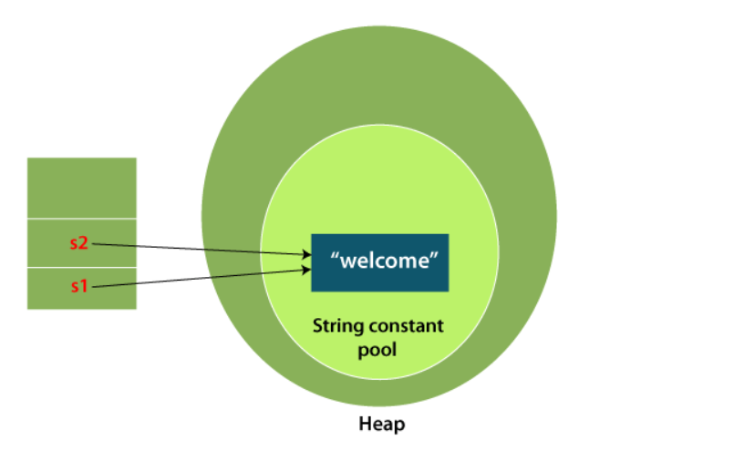

Slide 13
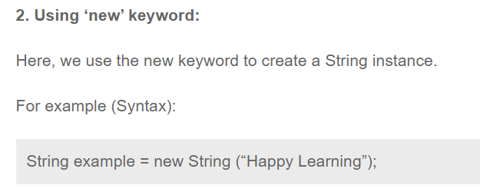

Slide 14
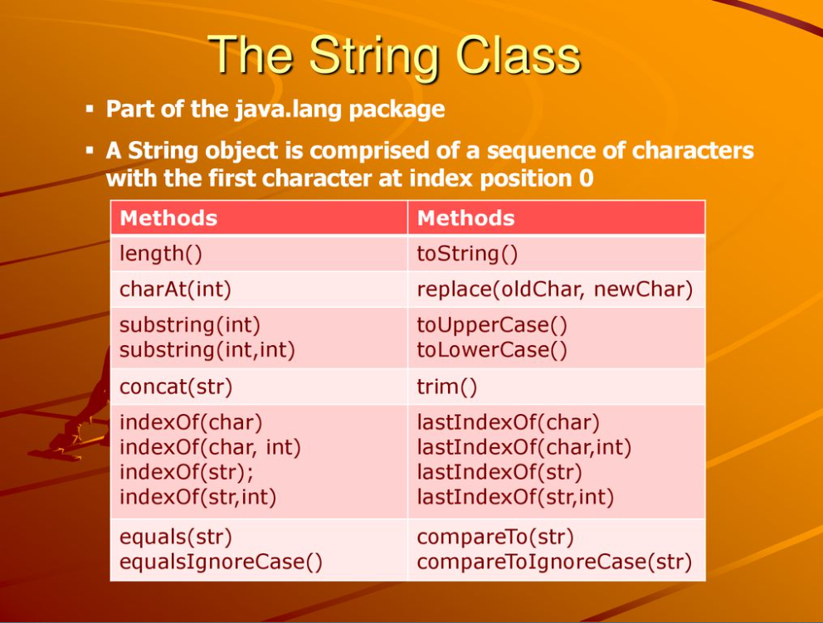

Slide 15
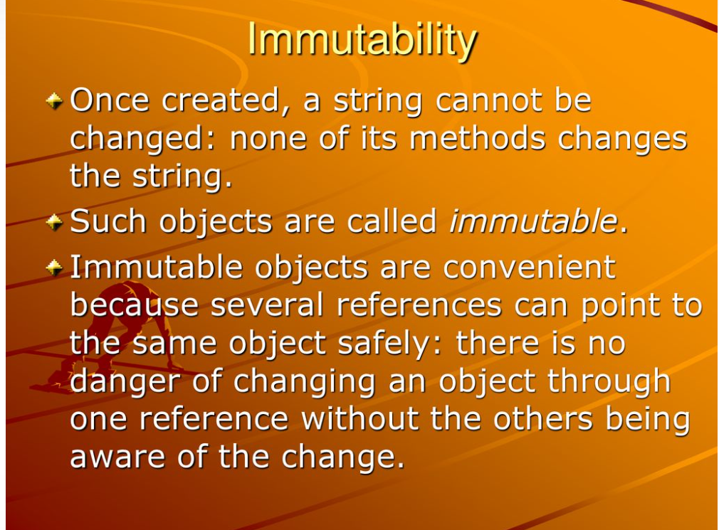

Slide 16
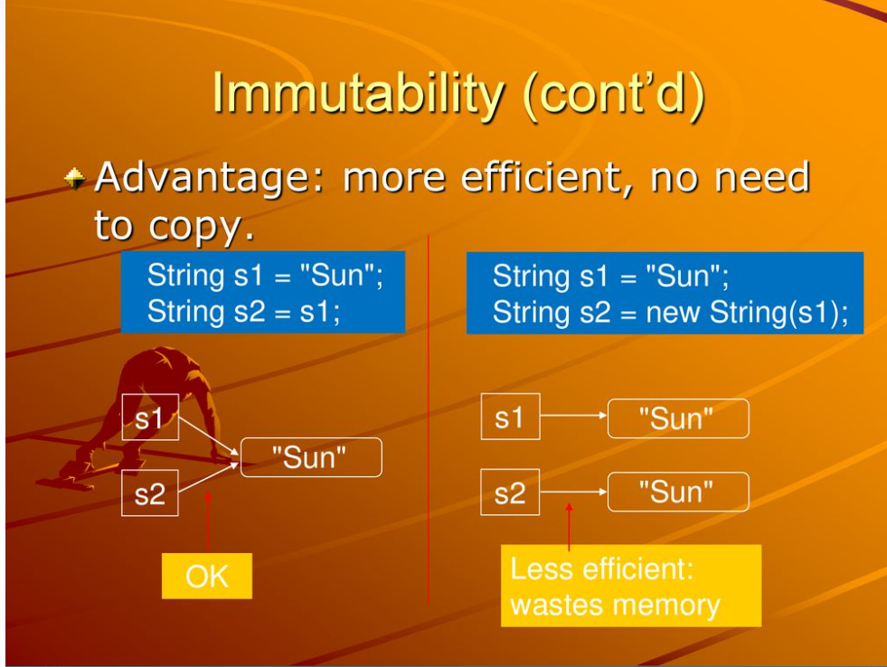

Slide 17
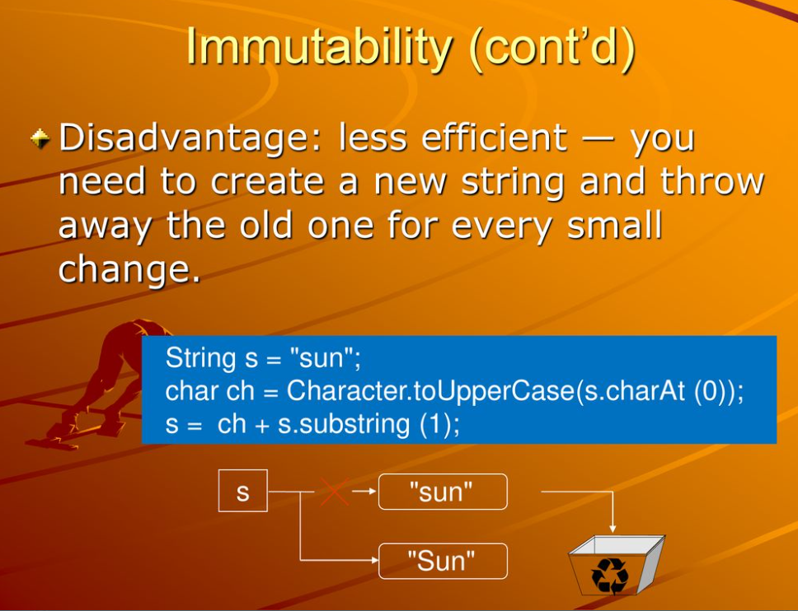

Slide 18
Why String objects are immutable in Java?

Slide 19
Java String compare

Slide 20
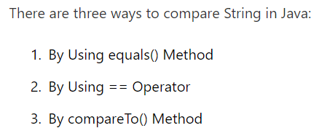

Slide 21
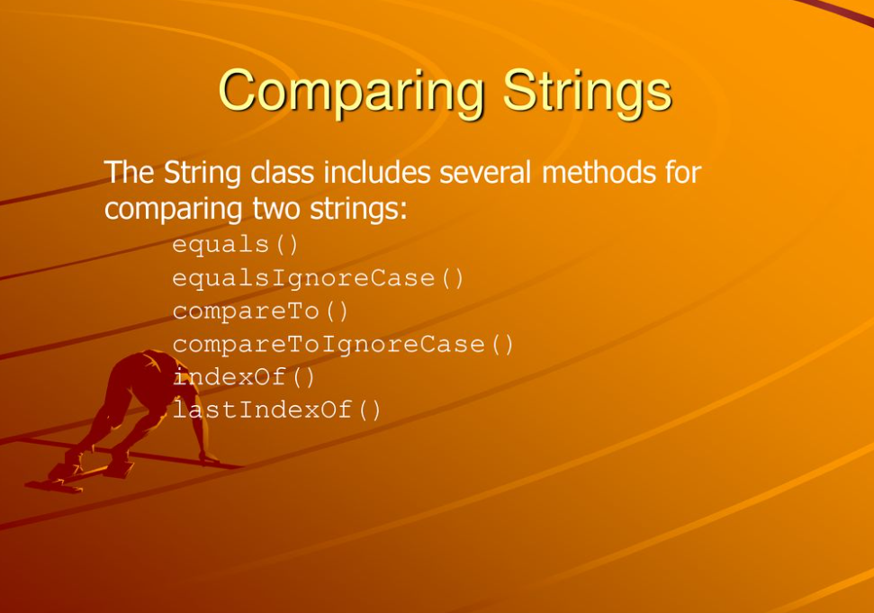

Slide 22
String Concatenation in Java

Slide 23
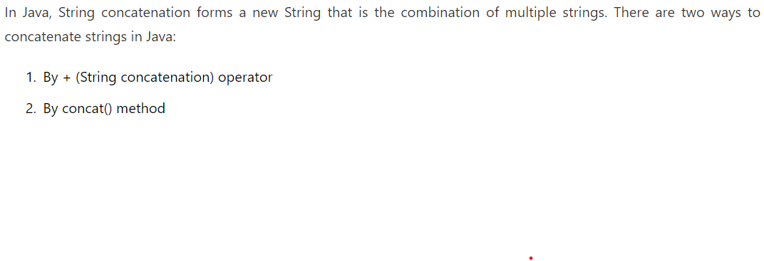

Slide 24
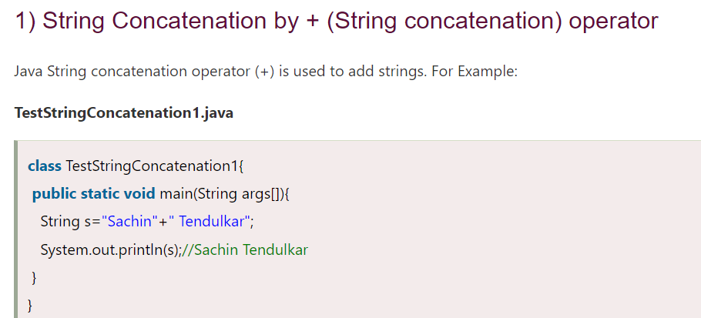

Slide 25
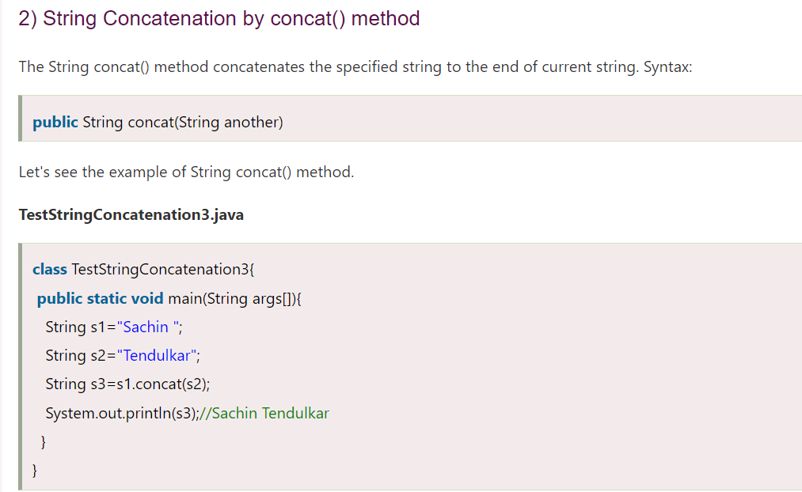

Slide 26
Substring in Java

Slide 27
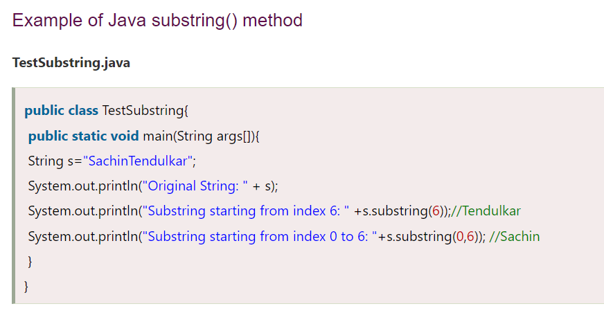

Slide 28
Java String Class Methods

Slide 29
Java String toUpperCase() and toLowerCase() method The java string touppercase() method converts this string into uppercase letter and string tolowercase() method into lowercase letter.

Slide 30
1. Java String trim() method 2. Java String startsWith() and endsWith() method 3. Java String charAt() Method 4. Java String length() Method 5. Java String intern() Method 6. Java String valueOf() Method 7. Java String replace() Method

Slide 31
Java StringBuffer and string builder

Slide 32
Important Constructors of string buffer class
Constructor | Description
StringBuffer() | It creates an empty String buffer with the initial capacity of 16.
StringBuffer(String str) | It creates a String buffer with the specified string..
StringBuffer(int capacity) | It creates an empty String buffer with the specified capacity as length.

Slide 33
Important methods of StringBuffer class

Slide 34
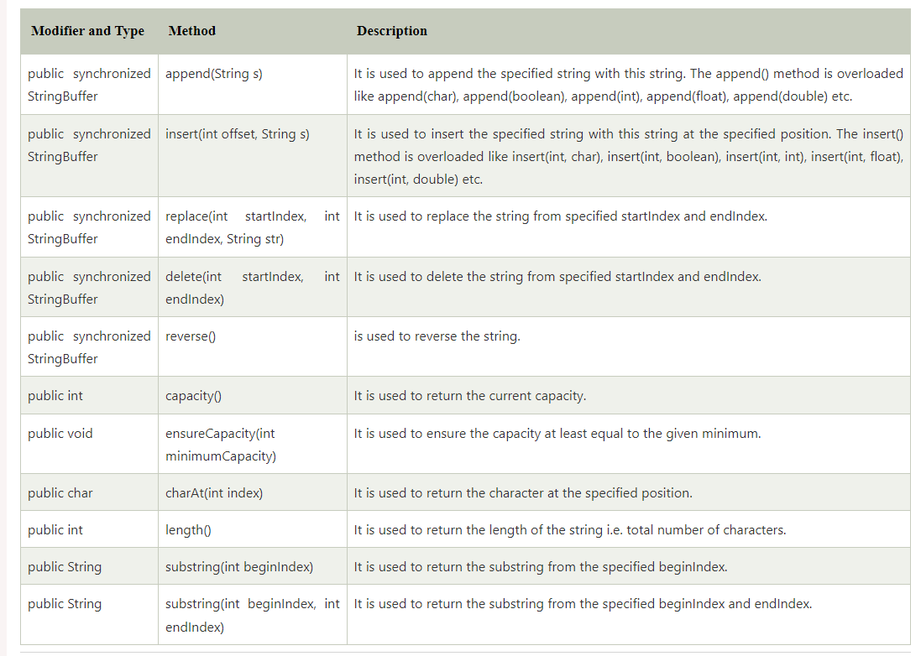

Slide 35
Important Constructors of StringBuilder class
Constructor | Description
StringBuilder() | It creates an empty String Builder with the initial capacity of 16.
StringBuilder(String str) | It creates a String Builder with the specified string.
StringBuilder(int length) | It creates an empty String Builder with the specified capacity as length.

Slide 36
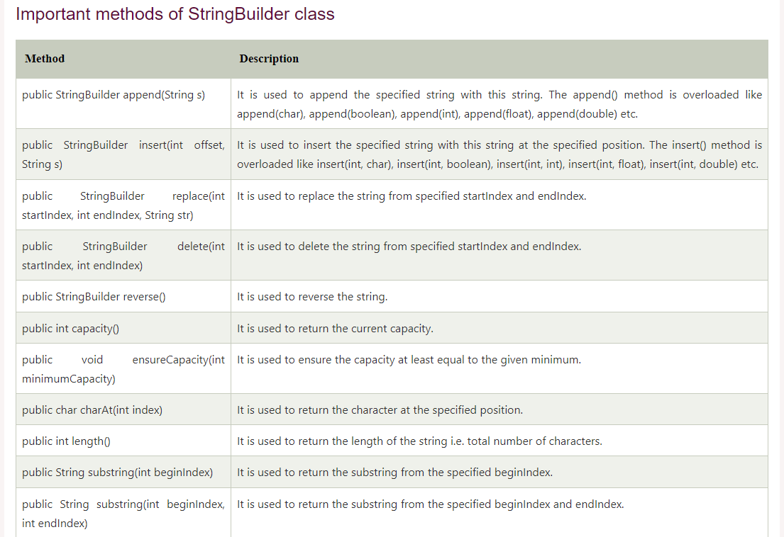

Slide 37
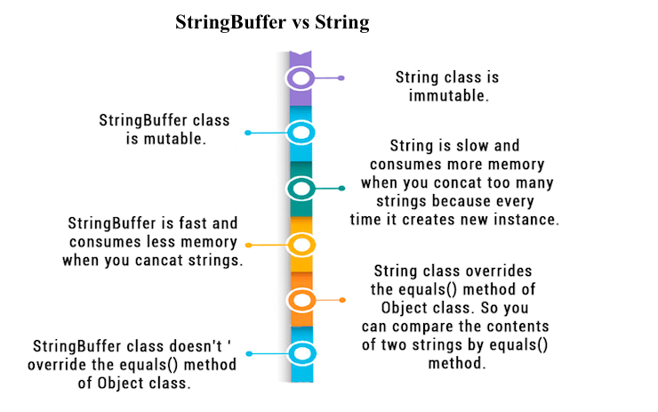

Slide 38
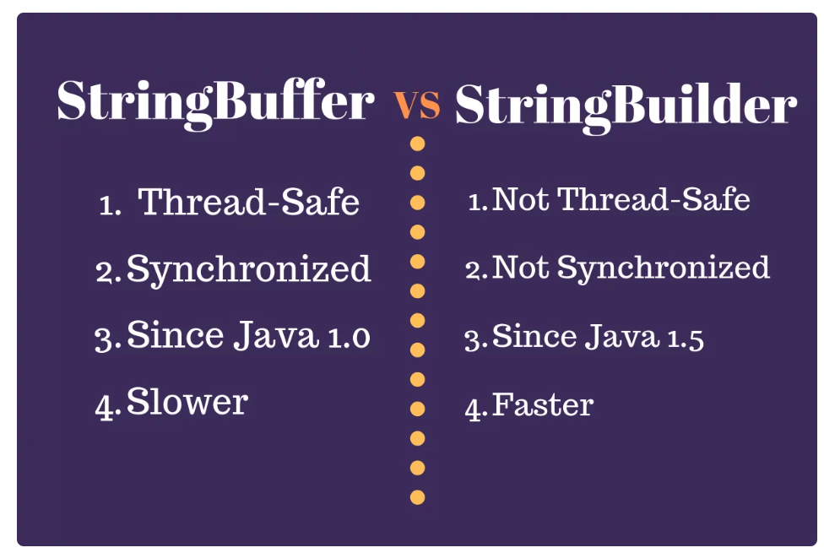

Slide 39
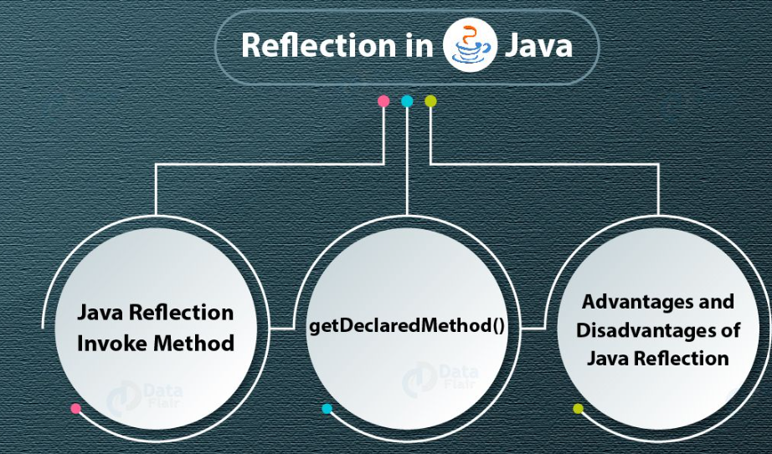

Slide 40
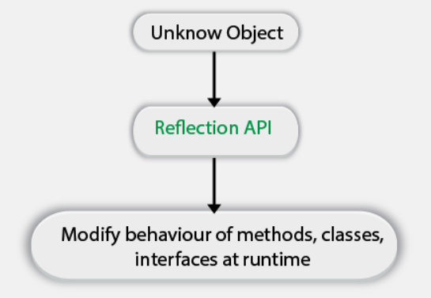

Slide 41
Reflection can utilize to get data about – Class- the getclass() method is utilized to get the name of the class to which an object has a place. Constructors- the getconstructors() technique is utilized to get the public constructors of the class to which an object has a place. Strategies- the getmethods() technique is utilized to get the public methods for the class to which an object has a place.

Slide 42
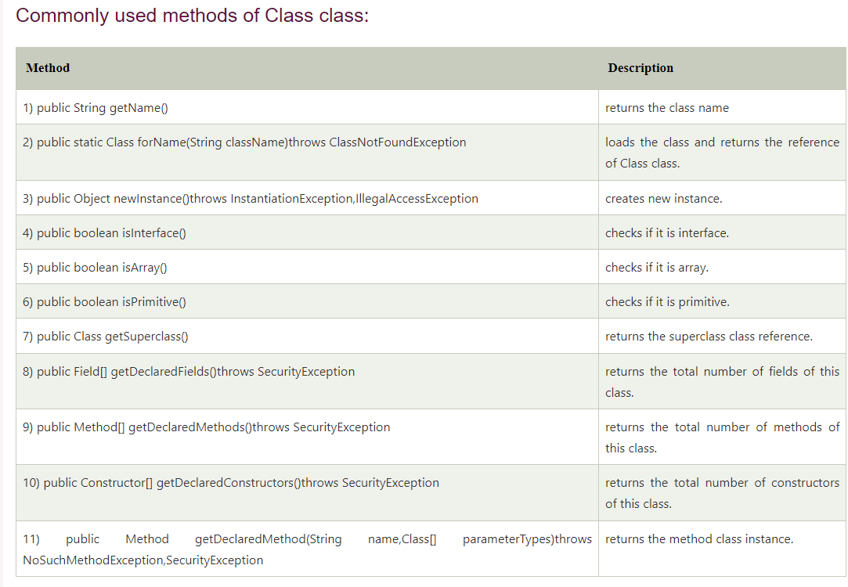

Slide 43
How to get the object of Class class? There are 3 ways to get the instance of class class. They are as follows: forname() method of class class getclass() method of object class the .Class syntax

Slide 44
Determining the class object 1) public boolean isInterface() 2) public boolean isArray() 3) public boolean isPrimitive()

Slide 45
Pros and Cons of Reflection

Slide 46
Thank you

